Slide 1
Effective Data Visualizations For All
Emily Rothenbacher
University of Alabama
evrothenbacher@ua.edu

Slide 2
What is data visualization?
“The representation and presentation of data that exploits our visual perception abilities in order to amplify cognition” –Andy Kirk
A part of the larger business intelligence (BI) umbrella
BI “helps organizations analyze historical and current data, so they can quickly uncover actionable insights for making strategic decisions”
Includes data preparation, data mining, data management, and data visualization
Notes:
books.google.com/books?hl=en&lr=&id=I4qBVLfD3t4C&oi=fnd&pg=PT6&ots=b7XMtLiI7q&sig=dAUXaw8qLiBX3To80ks1EypMssI
https://powerbi.microsoft.com/en-us/what-is-business-intelligence/
https://www.ibm.com/analytics/business-intelligence

Slide 3
Importance of data visualization
Effective method of communication
Offers different insights like patterns and comparisons
Visualizations help make data (especially big data)
Digestible
Accessible
And efficient
Notes:
https://www.eweek.com/big-data-and-analytics/data-visualization/

Slide 4
What makes a visualization effective?
Accurately and ethically represents source data
Made with the user in mind
Works with human perception
Accessible for all potential viewers
Leaves the viewer with actionable takeaways

Slide 5
Ethical data visualization
Data people are trusted keyholders
Ethics are a combination of journalism (reporting) and engineering (technical)
Use appropriate data gathering/selection and analysis
Choose most appropriate visualization rather than what looks good
Being clear
Being persuasive but not misleading
Notes:
https://mschermann.github.io/data_viz_reader/ethics.html

Slide 6
Example of a misleading visualization

Slide 7
Perception
Attention usually goes to title first
Utilize dynamic titles
Include key information and takeaways
Ex. “Differences in Friends Episode Ratings by Writer”
Keep it simple
Draw attention to important data, patterns
Adapt scale to visualization medium
Notes:
https://guides.library.jhu.edu/datavisualization/design
https://towardsdatascience.com/visual-perception-how-we-perceive-graphical-information-de5f30516009

Slide 8
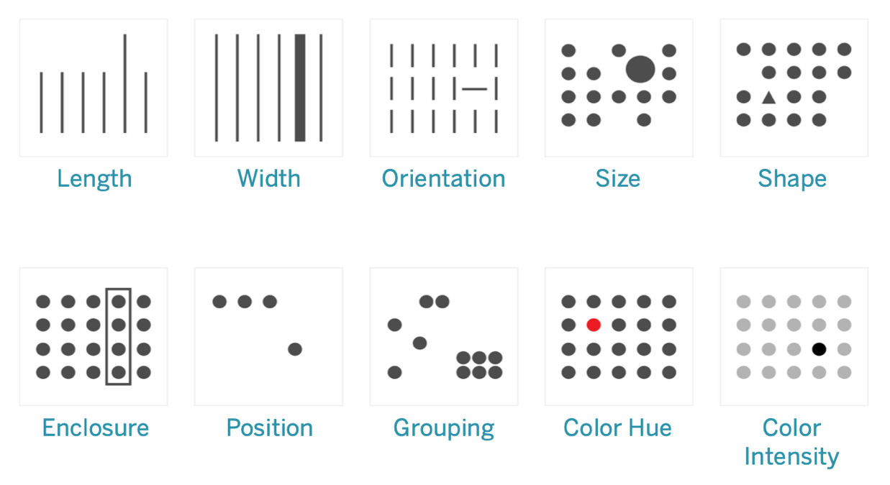
Preattentive processing
Notes:
https://help.tableau.com/current/blueprint/en-us/bp_why_visual_analytics.html

Slide 9
Example of drawing attention through preattentive processing

Slide 10
Color
Color can be used to convey meaning
Be careful, meaning can be cultural
Different types of color palettes based on type of data
Qualitative palette- no inherent ordering
Sequential palette- data is numeric or has natural order
Diverging palette- data is numeric and diverges from a center value
Rational palette- data has naturally related color (ex. university, country)
Notes:
https://guides.library.jhu.edu/datavisualization/design

Slide 11
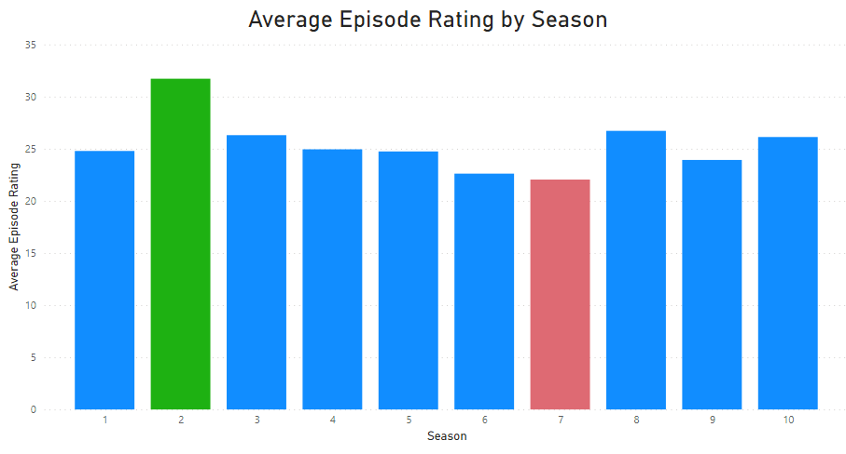
Example of meaning behind color

Slide 12
What type of visualization to use?
Type of data
Ex. Geospatial, temporal, network, 2D, 3D
Purpose of visualization
Ex. Comparison, relationship, distribution, range, flow
Viewing medium
Ex. Phone, computer, projector
Audience
Ex. Statisticians, college deans, potential future students

Slide 13
What type of visualization to use?
Data Viz Catalogue
Suggestions based on function/what is trying to be communicated
Data Viz Project
Suggestions categorized by family, data input, function, and shape
From Data to Viz
Decision trees based on type of data

Slide 14
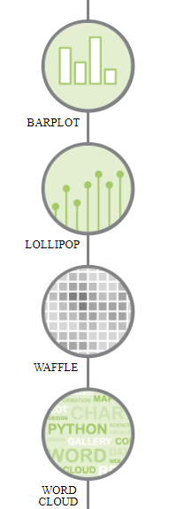
Example using From Data to Viz
Which of the Friends character had the most lines in the show?
What kind of data do you have?
Categoric
One categorical variable

Slide 15
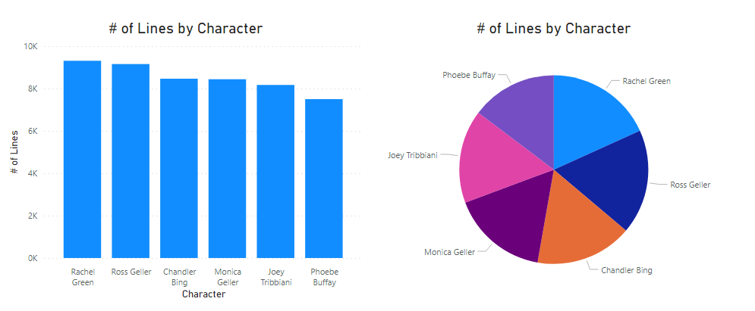
Example of choosing a visualization

Slide 16
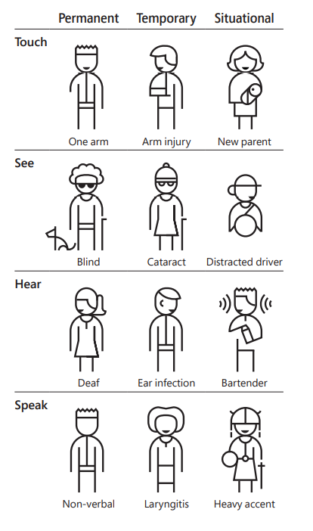
Accessibility
Web/visualization accessibility affects those with many types of disabilities, including
Auditory
Neurological
Physical
Visual
Notes:
https://www.w3.org/WAI/fundamentals/accessibility-intro/
https://www.microsoft.com/design/

Slide 17
Web Content Accessibility Guidelines (WCAG) 2.1
Created by the World Wide Web Consortium (W3C) as shared standard for web content accessibility
13 guidelines organized under 4 principles
Perceivable
Operable
Understandable
Robust
Notes:
https://www.w3.org/WAI/standards-guidelines/wcag/

Slide 18
Color
When using color, also include text or icons
Color blind friendly palettes
Pre-selected palettes or check your palette online
Coloring for Colorblindness
ColorBrewer
Check your website using Toptal Color Blind Filter or a web extension
Download Color Oracle for free to use in any program

Slide 19
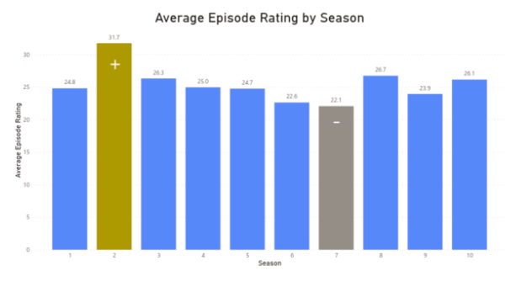
Example of protanopia (red-green) accessibility

Slide 20
Contrast
Some users with low vision cannot read text if there is not enough contrast between text and background
Others cannot read text in bright colors
Color Safe - accessible web color combinations
WCAG standard- AA is minimum level, AAA is enhanced
Sans serif or Atkinson Hyperlegible Font

Slide 21
This is low contrast
This is high contrast

Slide 22
Screen readers
Not just for blind users
Partially sighted, those with reading disorders
Descriptive, meaningful alt text
Should include type of visualization, type of data, and brief description of what visualization conveys
Can be navigated by keyboard
Free screen reader
For PC - NV Access | Download NVDA
For Apple – Apple VoiceOver
Also exist for Linux, Internet Explorer, Google Chrome
Notes:
https://it.wisc.edu/learn/accessible-content-tech/accessible-images-and-visualizations/
https://news.mit.edu/2021/data-visualizations-accessible-blind-1012

Slide 23
Example of screen reader alt text
Bar chart of average episode rating by season shows highest average at season 2 and lowest average at season 7

Slide 24
Clear, actionable takeaways
Think about the viewer’s perspective
Draw attention to important information
Be clear and succinct
Be honest

Slide 25
Best practice resources
Consumer Financial Protection Bureau (CFPB) Design Guidelines
Fonts, colors, components (labels, subtitles), accuracy, accessibility
WCAG guidelines
Preliminary quick checklist
Chartability
Provides accessibility-related tests for failure
Medicaid Data Visualization Best Practices
Power BI accessibility recommendations
Notes:
Data visualization guidelines - CFPB Design System
Easy Checks – A First Review of Web Accessibility | Web Accessibility Initiative (WAI) | W3C
Chartability (fizz.studio)
Tables, Graphs, Dashboard & Report Data Visualization Summary Best Practices (medicaid.gov)
Creating accessible reports in Power BI - Power BI | Microsoft Docs

Slide 26
Questions?

Slide 27
Sources
books.google.com/books?hl=en&lr=&id=I4qBVLfD3t4C&oi=fnd&pg=PT6&ots=b7XMtLiI7q&sig=dAUXaw8qLiBX3To80ks1EypMssI
https://powerbi.microsoft.com/en-us/what-is-business-intelligence/
https://www.ibm.com/analytics/business-intelligence
https://www.eweek.com/big-data-and-analytics/data-visualization/
https://mschermann.github.io/data_viz_reader/ethics.html
https://guides.library.jhu.edu/datavisualization/design
https://towardsdatascience.com/visual-perception-how-we-perceive-graphical-information-de5f30516009
https://help.tableau.com/current/blueprint/en-us/bp_why_visual_analytics.html
https://datavizcatalogue.com/search.html
https://datavizproject.com/
https://www.data-to-viz.com/
https://www.w3.org/WAI/fundamentals/accessibility-intro/
https://www.microsoft.com/design/
https://www.w3.org/WAI/standards-guidelines/wcag/

Slide 28
Sources
https://davidmathlogic.com/colorblind/
https://colorbrewer2.org/#type=sequential&scheme=BuGn&n=3
https://www.toptal.com/designers/colorfilter
https://colororacle.org/
http://colorsafe.co/
https://brailleinstitute.org/freefont
https://www.nvaccess.org/download/
https://it.wisc.edu/learn/accessible-content-tech/accessible-images-and-visualizations/
https://news.mit.edu/2021/data-visualizations-accessible-blind-1012
https://cfpb.github.io/design-system/guidelines/data-visualization-guidelines
https://www.w3.org/WAI/test-evaluate/preliminary/
https://chartability.fizz.studio/
https://www.medicaid.gov/state-resource-center/innovation-accelerator-program/iap-downloads/functional-areas/dataviz-best-practice.pdf
https://docs.microsoft.com/en-us/power-bi/create-reports/desktop-accessibility-creating-reports

